Slide 1
Polymorphism

Slide 2
Polymorphism
Polymorphism in C++ is exhibited by the ability of a pointer or reference to a base class type to behave in different ways when it is used to manipulate objects of different subtypes of that base class.
多形就是當你可以用基底class的指標或參考來進行處理時，卻可以依照其 subtype 來進行不一樣的事情（其實多形是很難用解釋的）

Slide 3
(Using a graphics application)
以繪圖應用程式為例處理為例
Suppose we have a base class called “shape”
Many shapes box, circle, rectangle…. Inherit shape.
In this type of application, it is inevitable you encounter such fragment of code to repaint all objects)
(在寫這一類的應用程式時，我們一定會寫到一個 function ，這個 function 是要重繪所有的繪圖物件，假設我們這些物件都放在一個
Suppose all the objects are put in a vector<shape *>container
void paintall(vector<shape *> & container) {
for each shape object x in container
x->draw();
}
In this example, we hope each object can draw its specific shapes.
在這個例子我們希望shape 物件 x 可以依照其原來的類別進行 draw() 的行為
我們可不希望前一堂課的按照 pointer 類別呼叫 method 的狀況出現

Slide 4
Virtual functions
任何想要被繼承的 class overridden 的method 都要宣告成 virtual
一個function 一旦宣告成virtual，則在繼承的class 中也是 virtual。但是可以忽略不寫，不過建議要寫
Polymorphism only works for pointer and reference with function that declared as virtual (多型只對 pointer, reference,以及宣告為 virtual 的function 有效)
If a class has any method declared as virtual, its destructor should be declared as virtual. (如果一個 class 有任何一個 method 宣告為 virtual 則 destructor 也應該宣告為 virtual ，這為了確保正確的 destructor 做正確的清除 )
class Pet
{
public:
// Constructors, Destructors
Pet () {}
virtual ~Pet() {}
//General methods
virtual void speak();
void breath();
};

Slide 5
Comments
The method, breath(), is not declared as virtual. Why? Because I am assuming that all animals breath and that this method will not be overridden in base classes.
Suppose that later some programmer defines a "fish" subclass. Then, perhaps, breath needs to be overridden to allow for underwater breathing. For now, I'll assume it's adequate.
Why not declare all methods as virtual?
  This could be done, but involves additional overhead. The compiler creates a virtual function table that is used in the polymorphism mechanism. Avoiding unnecessary details, the more functions that are declared as virtual, the greater the overhead to create and maintain these tables.
  But, by declaring all methods virtual, redesign may be avoided if the classes need to change.
Some C++ programmers declare all methods virtual if any need be. Some don't. In some programming languages, such as Java, all methods are virtual by default. I don't have a definitive answer on this one.

Slide 6
#include <iostream>
#include <string>
using namespace std;
class Pet
{
public:
// Constructors, Destructors
Pet () {}
virtual ~Pet() {}
//General methods
virtual void speak();
void breath() { cout << "Gasp" << endl;}
};
void Pet::speak() { cout << "Growl" << endl;}
class Rat: public Pet
{
public:
Rat() {}
~Rat() {}
void speak();
};
void Rat::speak() { out << "Rat noise" << endl;}
class Cat: public Pet {
public:
Cat() {}
~Cat() {}
void speak();
};
void Cat::speak() {cout << "Meow" << endl;}
void chorus(Pet pet, Pet *petPtr, Pet &petRef)
{
pet.speak();
petPtr->speak();
petRef.speak();
}
int main()
{
Pet *ptr; //Pointer to base class
ptr = new Pet;
cout << "Pet Created" << endl;
cout << "Pets singing" << endl;
chorus(*ptr,ptr,*ptr);
cout << endl << endl;
delete ptr; //Prevent memory leaks
ptr = new Rat;
cout << "Rat Created" << endl;
cout << "Rats singing" << endl;
chorus(*ptr,ptr,*ptr);
cout << endl << endl;
delete ptr; //Prevent memory leaks
ptr = new Cat;
cout << "Cat Created" << endl;
cout << "Cats singing" << endl;
chorus(*ptr,ptr,*ptr);
cout << endl << endl;
delete ptr; //Prevent memory leaks
return 0;
}

Slide 7
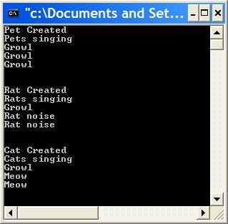

Slide 8
Object Slicing
You may recall that when you pass an argument by value, a copy is made.
In this example, the compiler makes space for a Pet object and then copies the Rat object argument into it. Since the Rat object is larger, it doesn't fit. This is called slicing. Only the Pet part of Rat gets copied. When speak is called, it is Pet's speak method that is executed.

Slide 9
Polymorphism
When passed a pointer of type Pet holding the address of a Rat object, we get Rat behavior - "rat noise" is printed. This is polymorphism.
Polymorphism is seen when a pointer or reference of a base class points to a subclass object.
Methods must be declared as virtual for polymorphism to work.

Slide 10
An array of pointers
#define MAXCAPACITYINROOM 50
int main()
{
int quit = 0;
int choice;
int totalNumber;
Pet *house[MAXCAPACITYINROOM];
//Array of pointers to base class
int i = 0;
while (!quit && i < MAXCAPACITYINROOM)
{
cout << "Enter (0) to quit" << endl;
cout << "Enter (1) for Rat" << endl;
cout << "Enter (2) for Cat" << endl;
cin >> choice;
if (choice == 0) {
quit = 1;
}
else if (choice == 1) {
house[i++] = new Rat();
} else if (choice == 2) {
house[i++] = new Cat();
} else {
cout << "Invalid Choice, Reenter" << endl;
}
}
totalNumber = i;
for (i = 0; i < totalNumber; i++)
{
house[i]->speak();
}
return 0;
}

Slide 11
Comments
Why have I chosen an array of pointers of the base class type, "Pet", to store my pets as I enter them into the program. Because I do not know at compile time the type of each subclass object (Rat or Cat) and need to be able to store either.
I need each to behave as the subclass it is. I want polymorphism. That is, I want each object to have the appropriate behavior according to its subclass.
An array of objects would not work. Remember, polymorphism is supported through pointers and references.

Slide 12
The principle of polymorphism

Slide 13

OOP (the four basic elements)
物件與 message
Dynamic binding
(via polymorphism)
inheritance
encapsulation

Slide 14
Polymorphism
在物件導向的語言中，polymorphism (多型） 是 inheritance , message passing 所自然結合產生的結果
What is polymorphism?
函示在執行的時候，面對不同的型別或物件，能有自動相對應的操作及功能
與overloading 多出來的功能，是在於可以真正的以一段同樣的程式碼對不同的 資料型別或物件進行操作

Slide 15
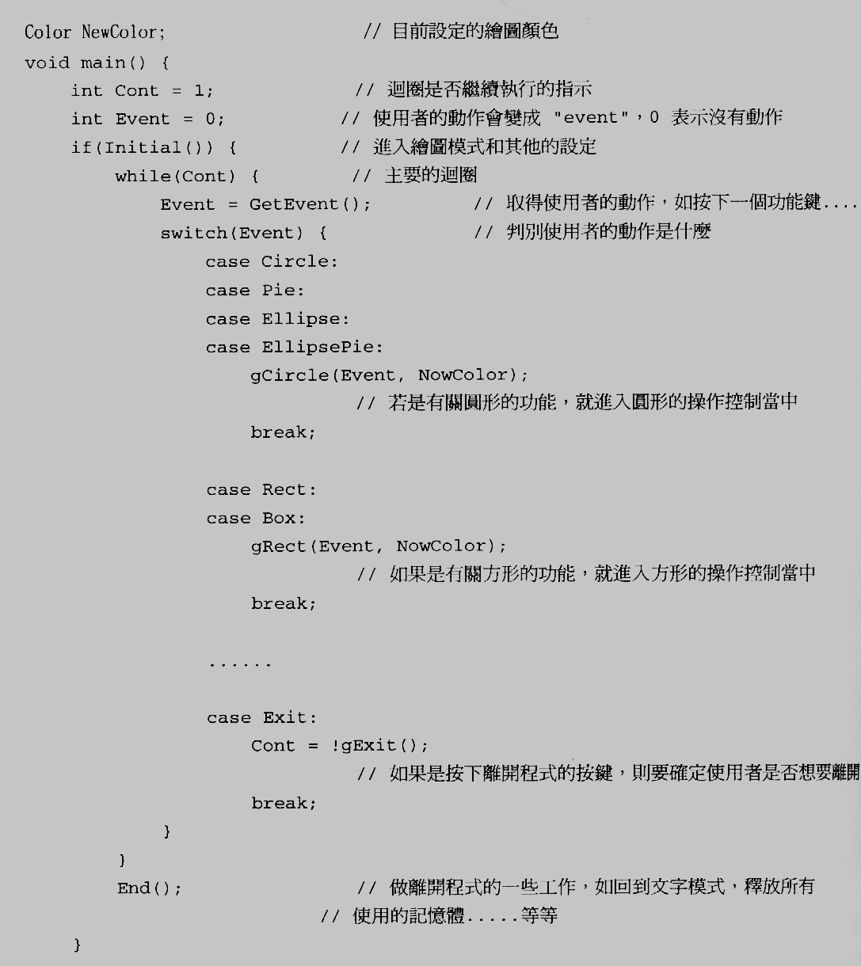
making polymorphism without OOP

Slide 16
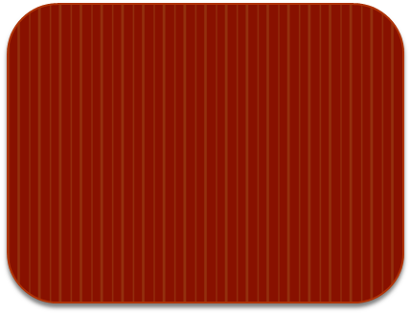
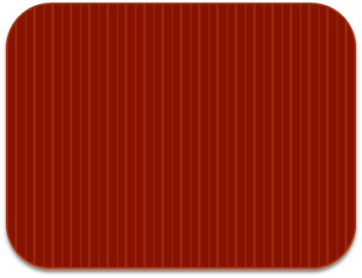
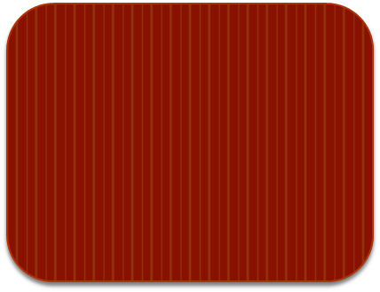
Switch Patterns often appear in several places
Switch(xxx) {
Case x: …
Case y:…
Case z: ….
Switch(xxx) {
Case x: …
Case y:…
Case z: ….
Switch(xxx) {
Case x: …
Case y:…
Case z: ….
Switch(xxx) {
Case x: …
Case y:…
Case z: ….

Slide 18
function pointer
int (*f)(int, int) ;
int (*f[])(int,int);

Slide 19
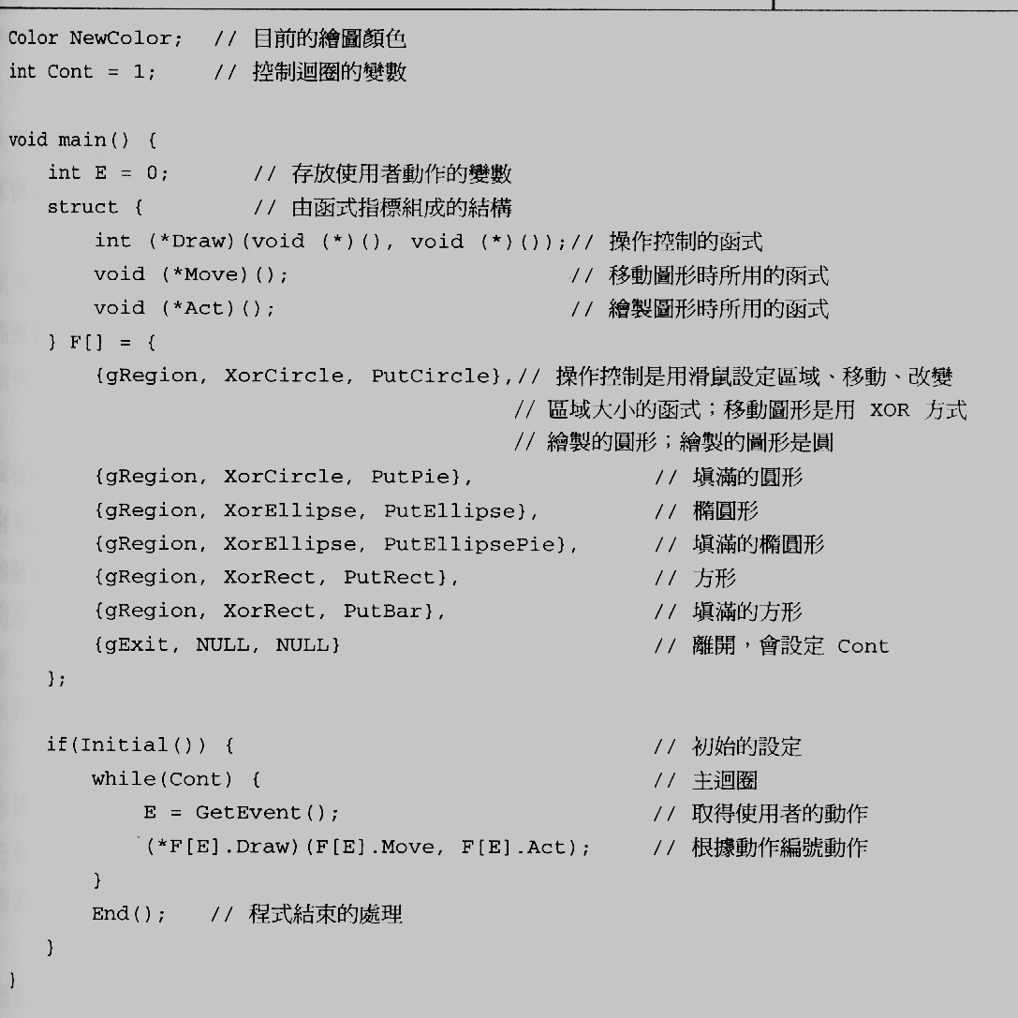
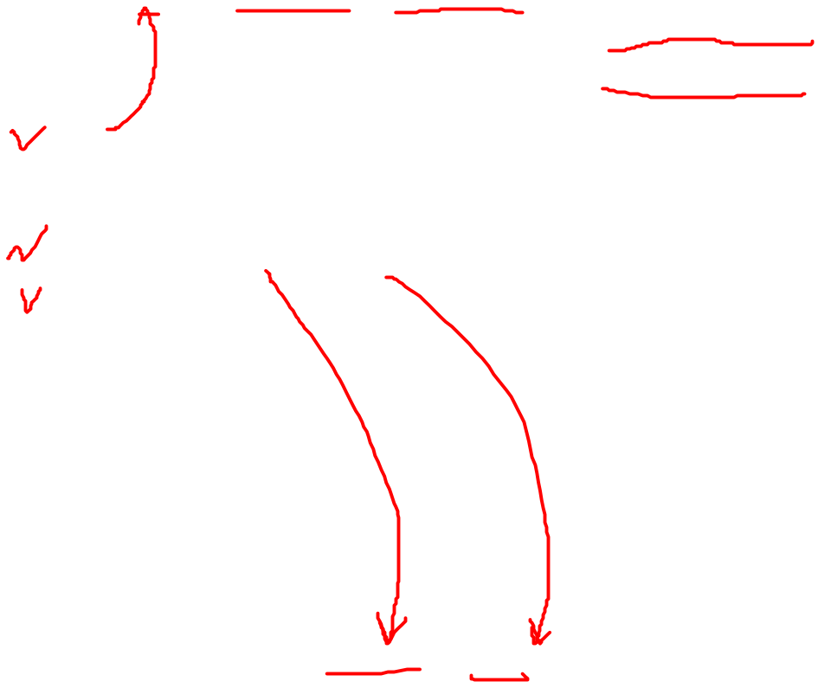
this are functions

Slide 20
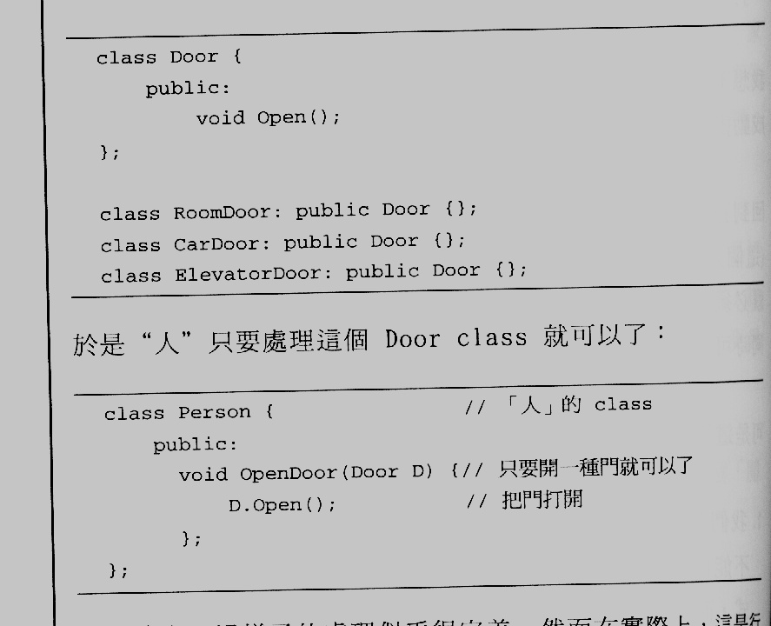
Inheritance without polymorphism
class RoomDoor : public Door {
public:
void Open();
}
If you pass any door such as RoomDoor, Cardoor, ElevatorDoor, OpenDoor
will always invokes the Open() of Door.

Slide 21
Inheritance along cannot implement polymorphism.
We need a new mechanism called dynamic binding to make polymorphism to work.
我們需要一種新的機制，使我們能夠用同樣的操作方式，完成不同實質內容的動作
也就是動態連結 （dynamic binding)

Slide 22
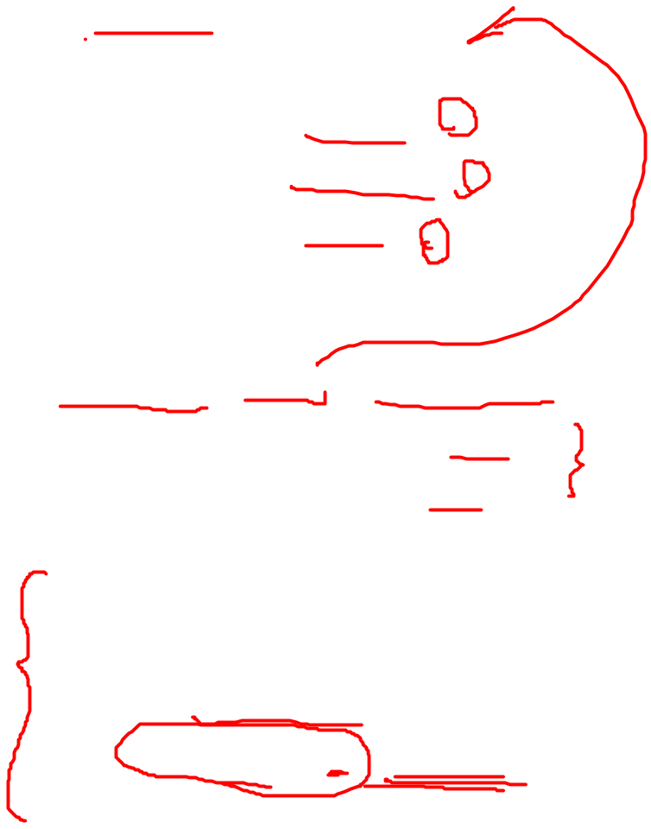
Recall the previous example:
Making polymorphism with OOP
class Circle : Public Shape{
public:
virtual void Draw() { …..}
virtual void Move() { ….}
virtual void Act() { ….}
};
void main () {
Vector <Shape *> ShapePool ;
ShapePool.insert(new Circle);
ShapePool.insert(new Pie);
……….
if (initial()) {
while (cont) {
E = GetEvent();
ShapePool[E]->Draw();
}
}
How can this be achieved?

Slide 23
How polymorphism is implemented?
Lets’ see the binding of compiler and linker

Slide 24
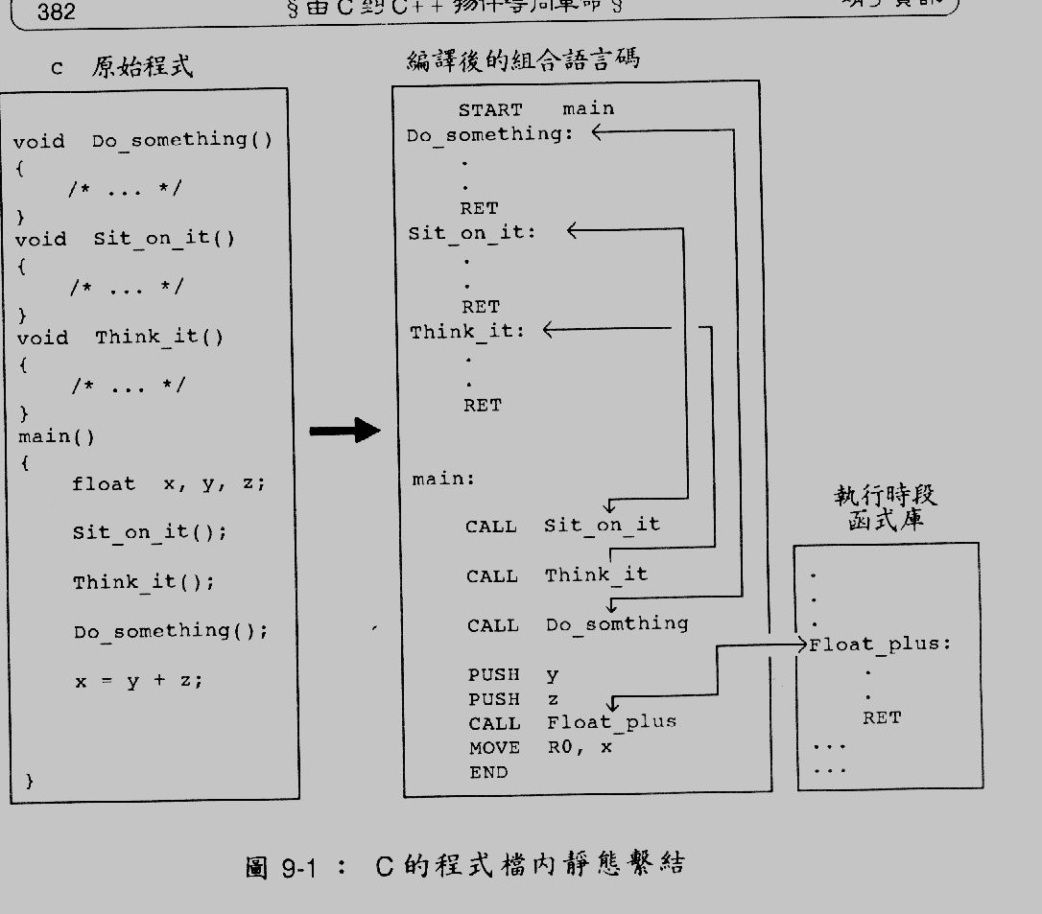
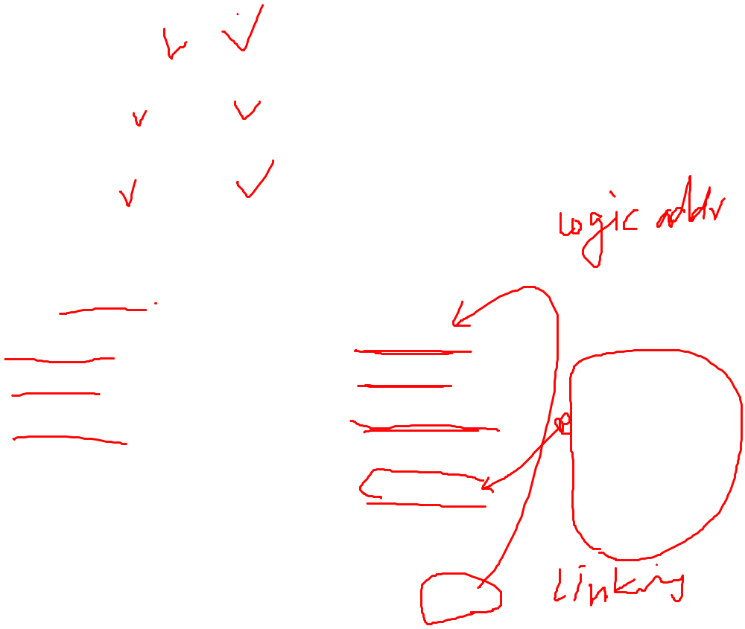

Slide 25
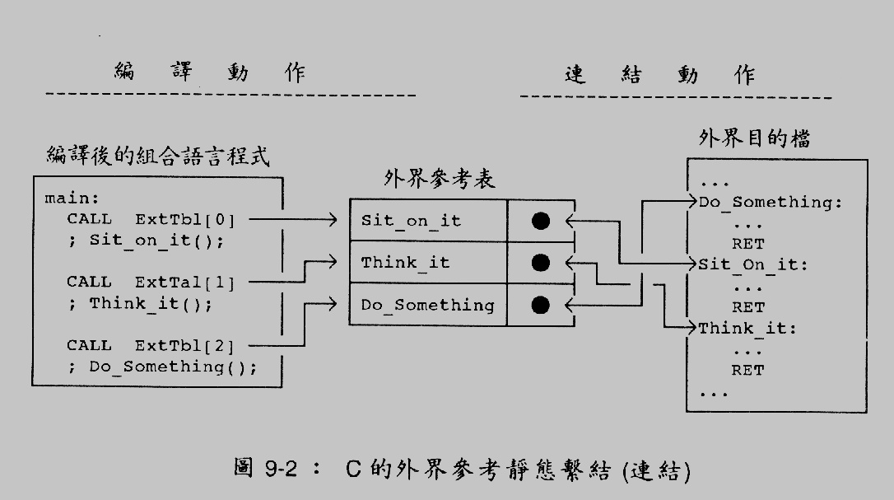

Slide 26
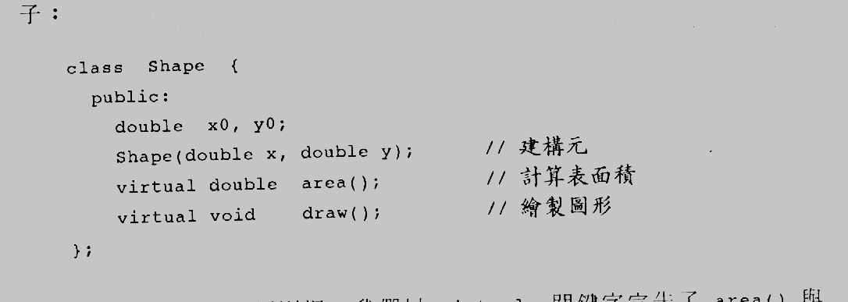
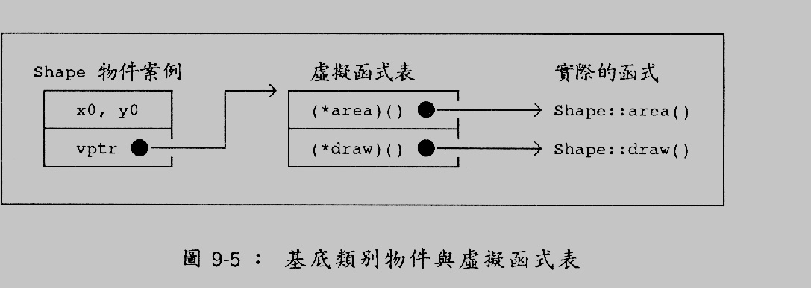
Dynamic Binding
Let’s see an example

Slide 27
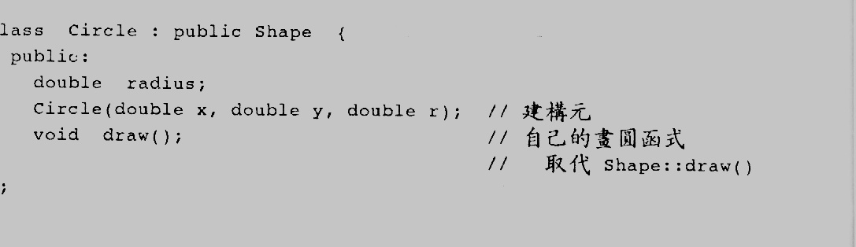
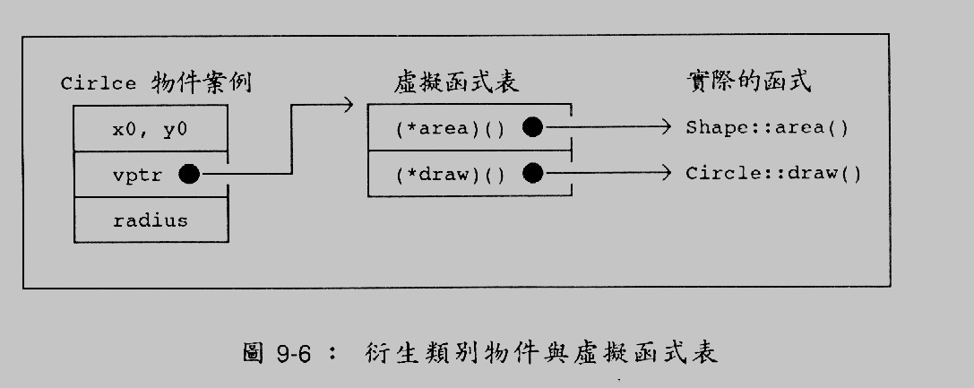

Slide 28
Compiler translation
Shape *p ;
Shape A ;
Circle B ;
p = &A ;
p->draw();
p = &B ;
p->draw()
(p->vptr[1])();
(p->vptr[1])();

Slide 29
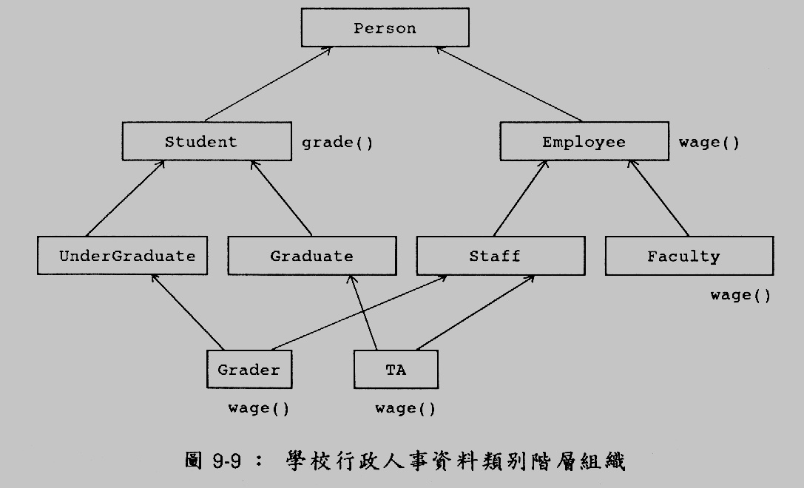
OOA
Let’s go back to OOA again
In a school wage system you want to analyze it and obtain an inheritance hierarchy as follows

Slide 30
Fact !
Actually, writing OO programs is a process, not just programming
Most programmers learn OOP (C++,Java) first, without knowing that writing OO programs require a planning and design first.
It is a process not a programming task
Its goal : to make the system highly reusable and maintainable

Slide 31
Why OO programs are easily maintainable if it is done perfectly?
class Circle : Public Shape{
public:
virtual void Draw() { …..}
virtual void Move() { ….}
virtual void Act() { ….}
};
void main () {
Vector <Shape *> ShapePool ;
ShapePool.insert(new Circle);
ShapePool.insert(new Pie);
……….
if (initial()) {
while (cont) {
E = GetEvent();
ShapePool[E]->Draw();
}
}
Take the following examples again. When you want to extend the system to another shape called Polyghon
You simply write a class to extend Shap and add a new
line in main () or some function called init() and then you do not need to change other parts of the program

Slide 32
Virtual Base Class (Abstract class)
In C++, class that has member functions are pure virtual function, such as
  virtual void p() = 0 ;
這些 class 稱為 abstract class, 沒有 instance
  也就是你在程式中不會從 abstract class new 出 instances
  class Human {
  public:
  virtual Money work() = 0 ;
  };

Slide 33
Thumb rule
If a member function can be overridden by subclass, declare it as virtual
假設某個member function 以後有可能會被derived class修改，就在他的前面加 virtual 就對了。
假如你喜歡用多重繼承，那麼只要這個class可能有兩個以上的 derived class 則你應該在繼承他的時候在前面加上 virtual

Slide 34
Question
Why not making an abstract class to have all the methods to be abstract and enforce its subclasses to implement each methods? Such as
  class Human {
  public:
  virtual void walk() = 0 ;
  virtual void breath() = 0 ;
  virtual void speak()=0;
  };

Slide 35


Slide 36
One Critical Point to Determine if you OO program is really doing right
class base {
int a ;
int b ;
}
class something : base {
int c ;
}
Somewhere in the code
….
…
…
something s = new something() ;
….
s.

